Slide 1
Artifact Tracking Database
Josh, David, Fletcher, Matt

Slide 2
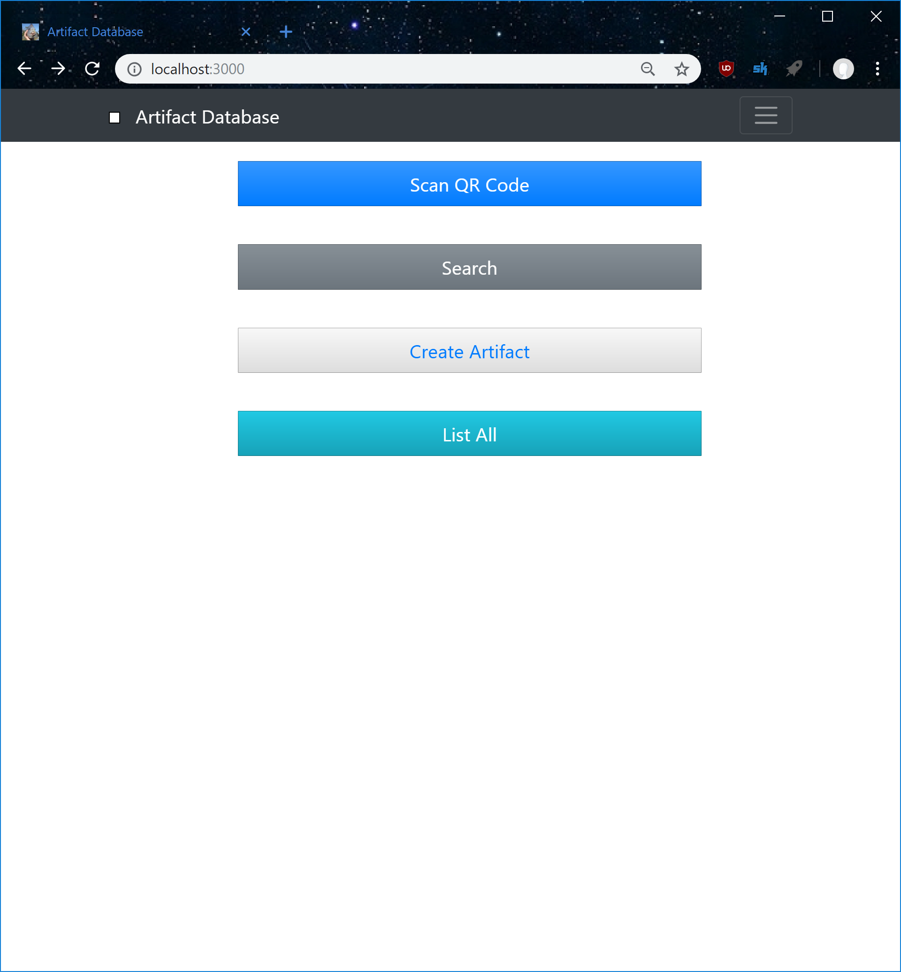
Updated Root

Slide 3
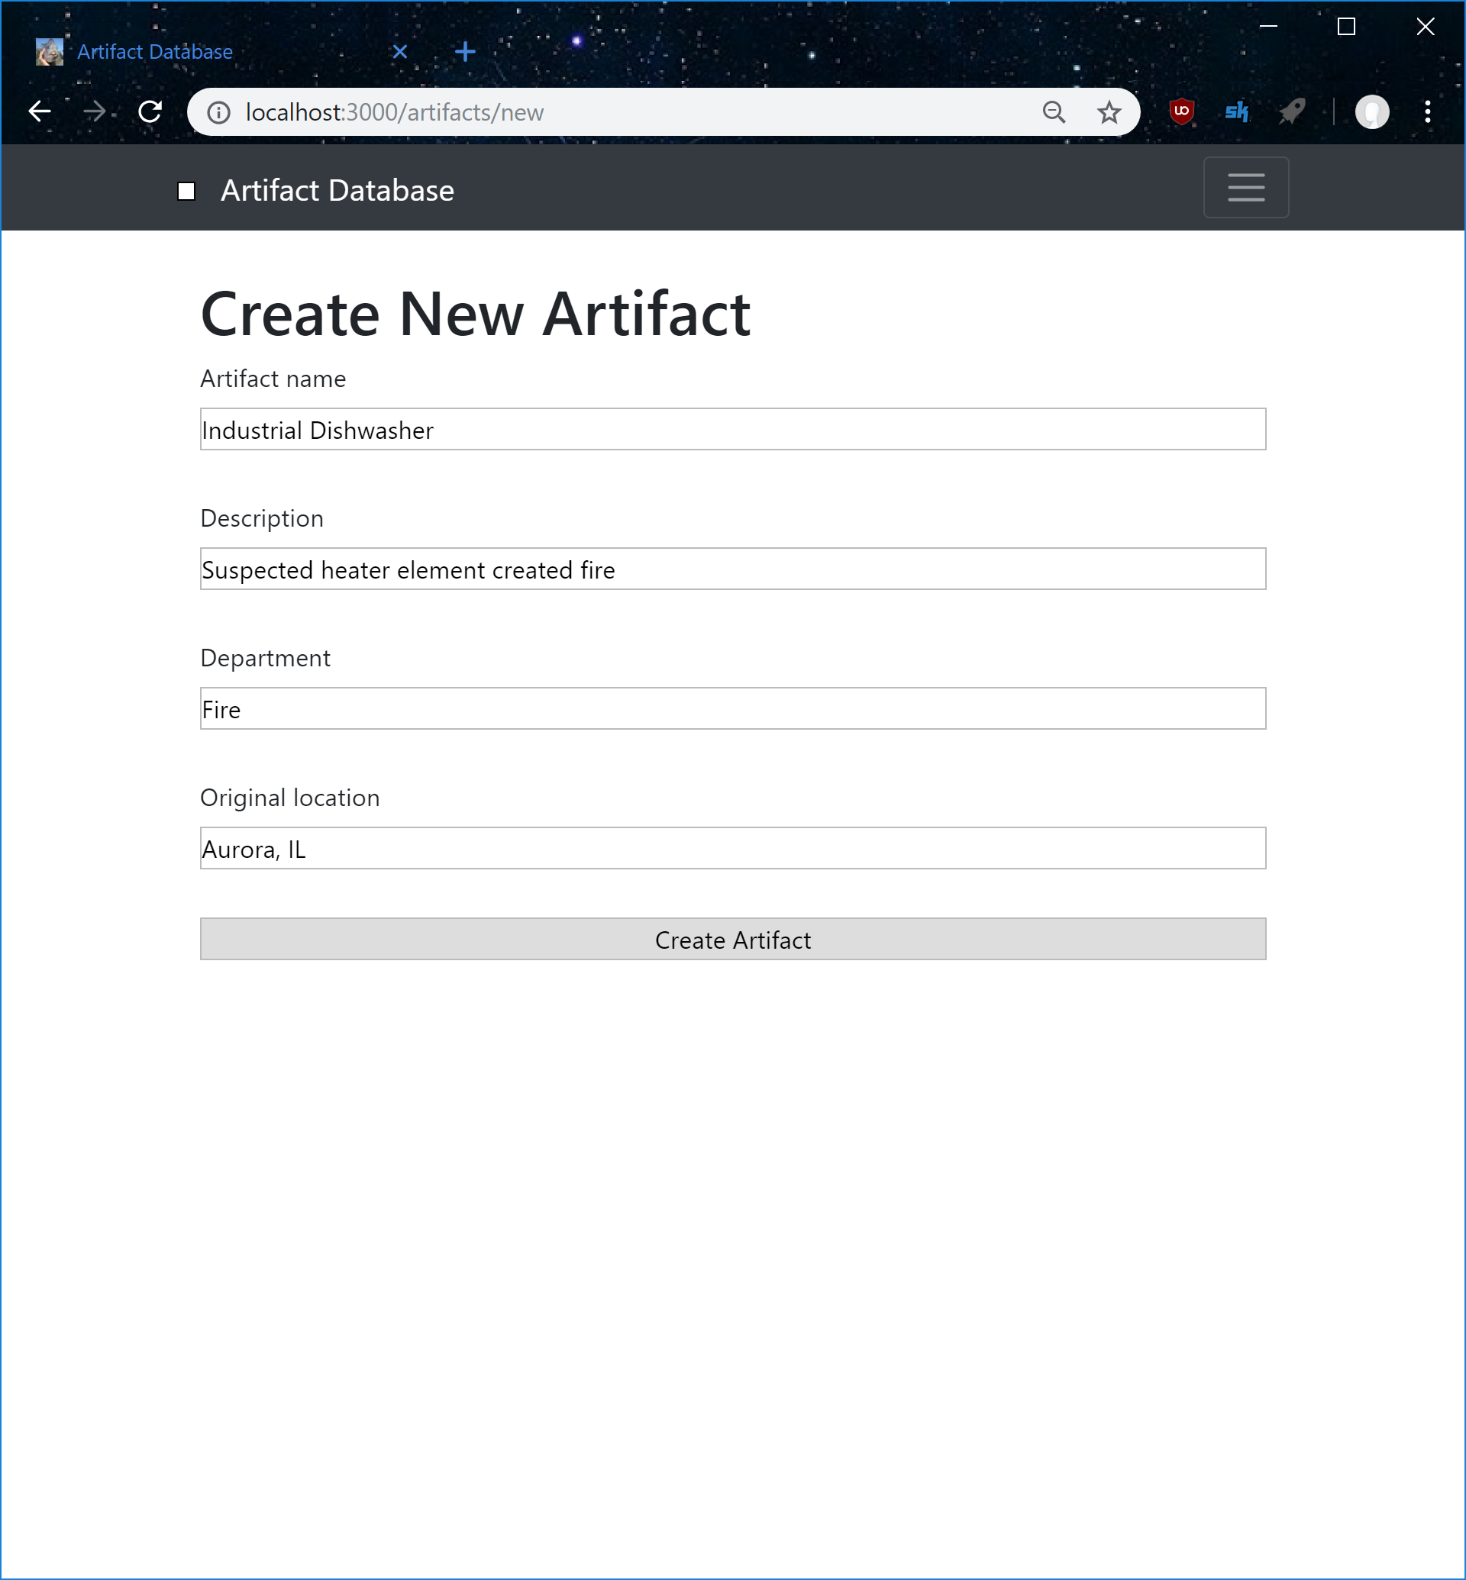
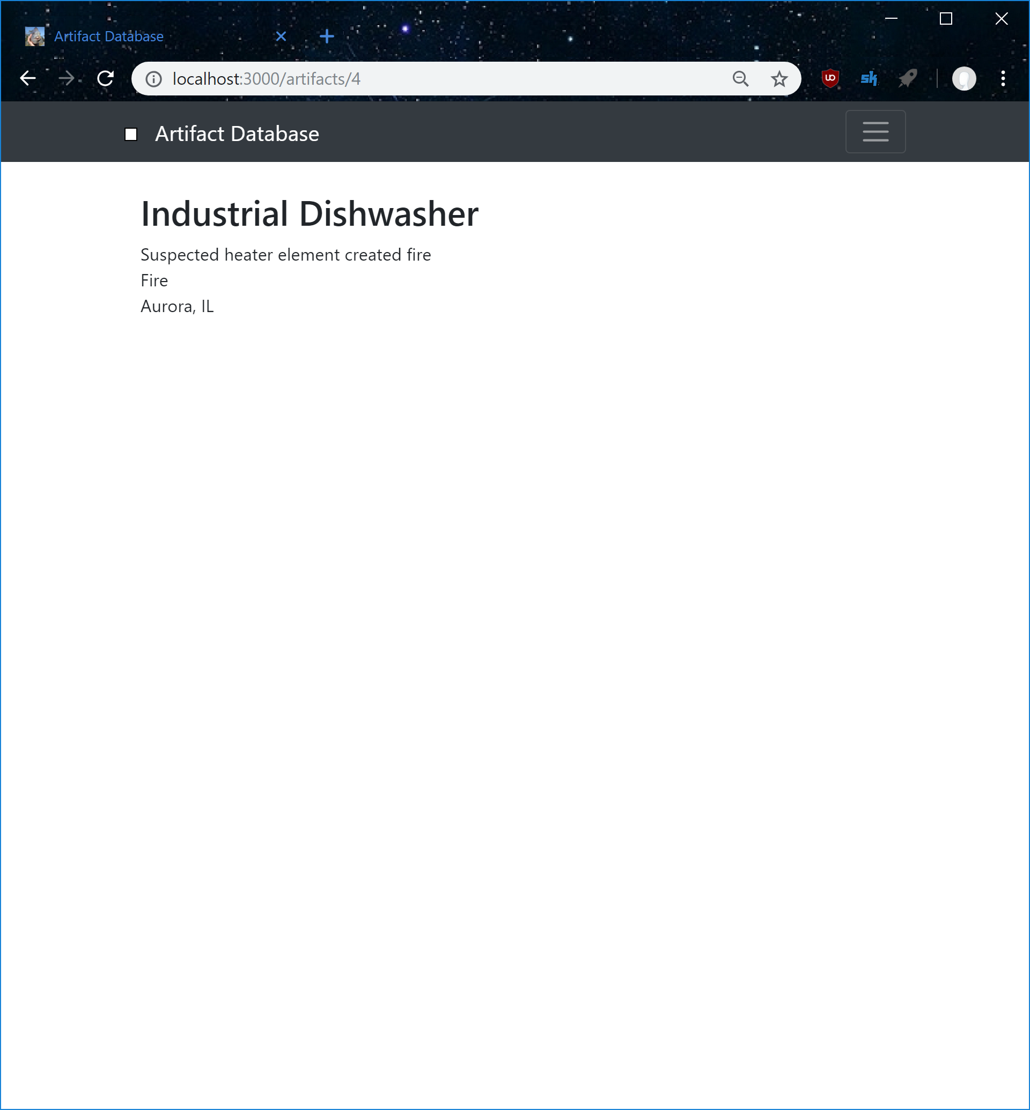
Create Artifacts

Slide 4
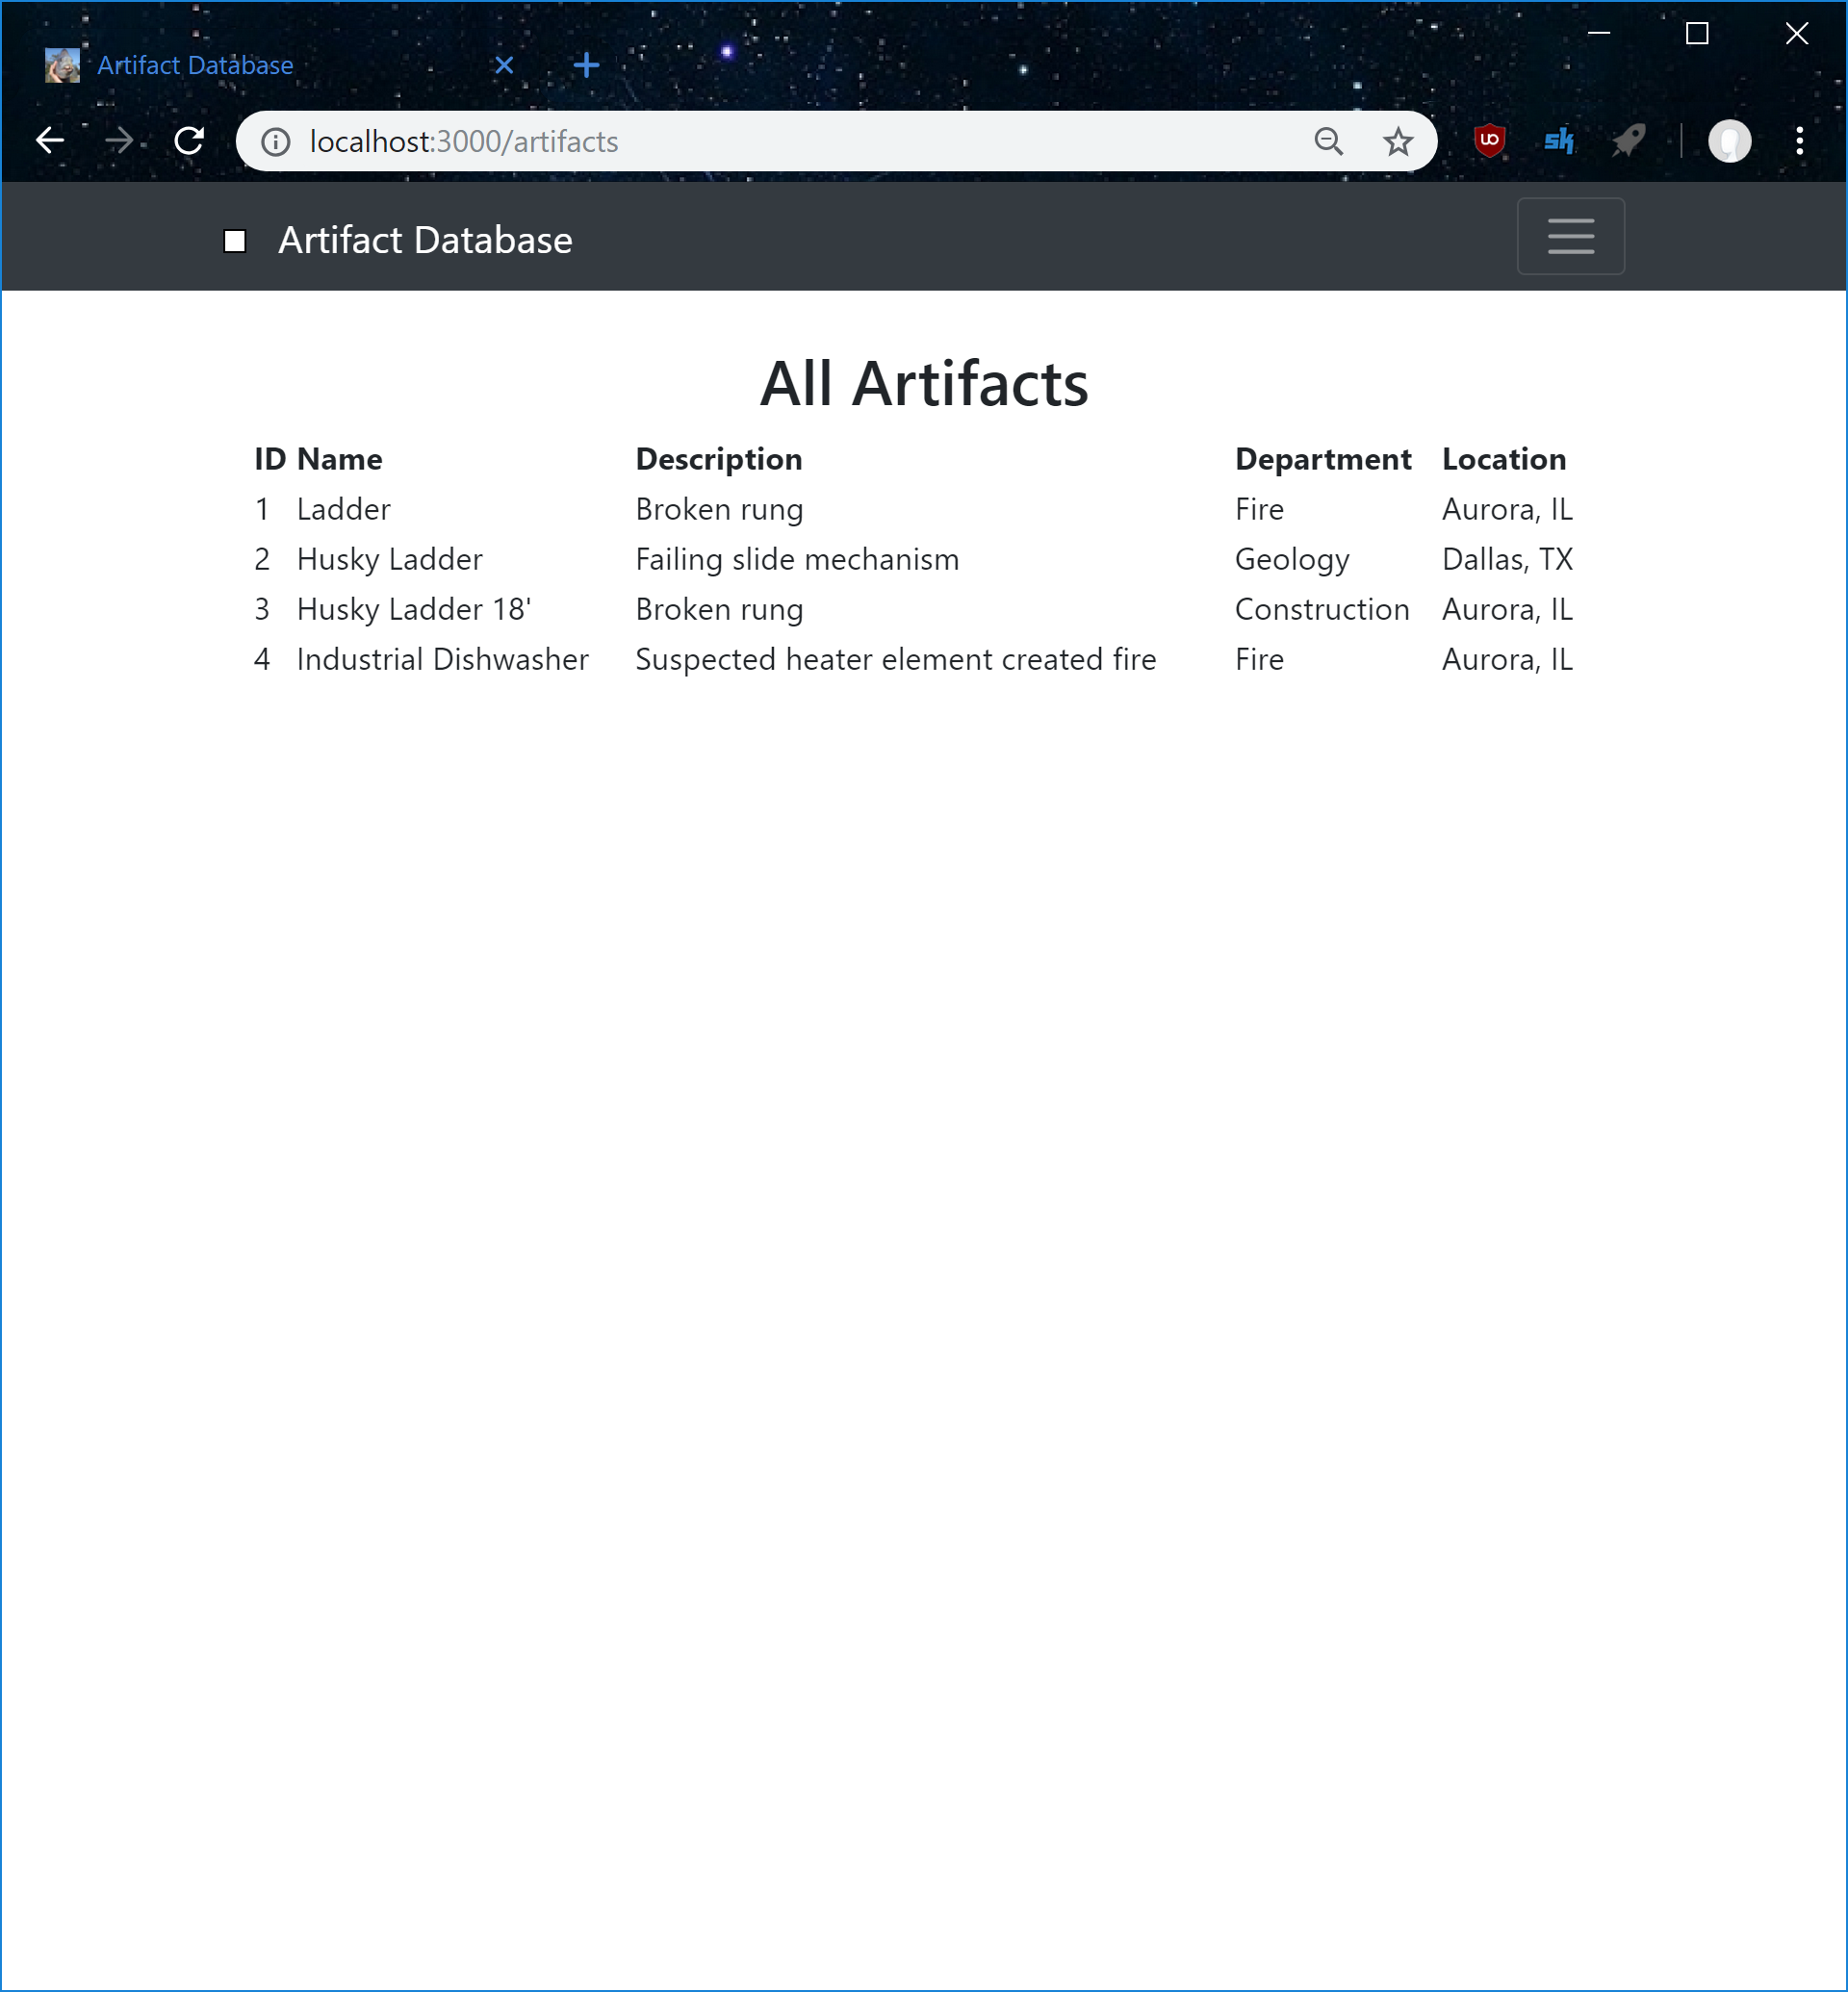
List all

Slide 5
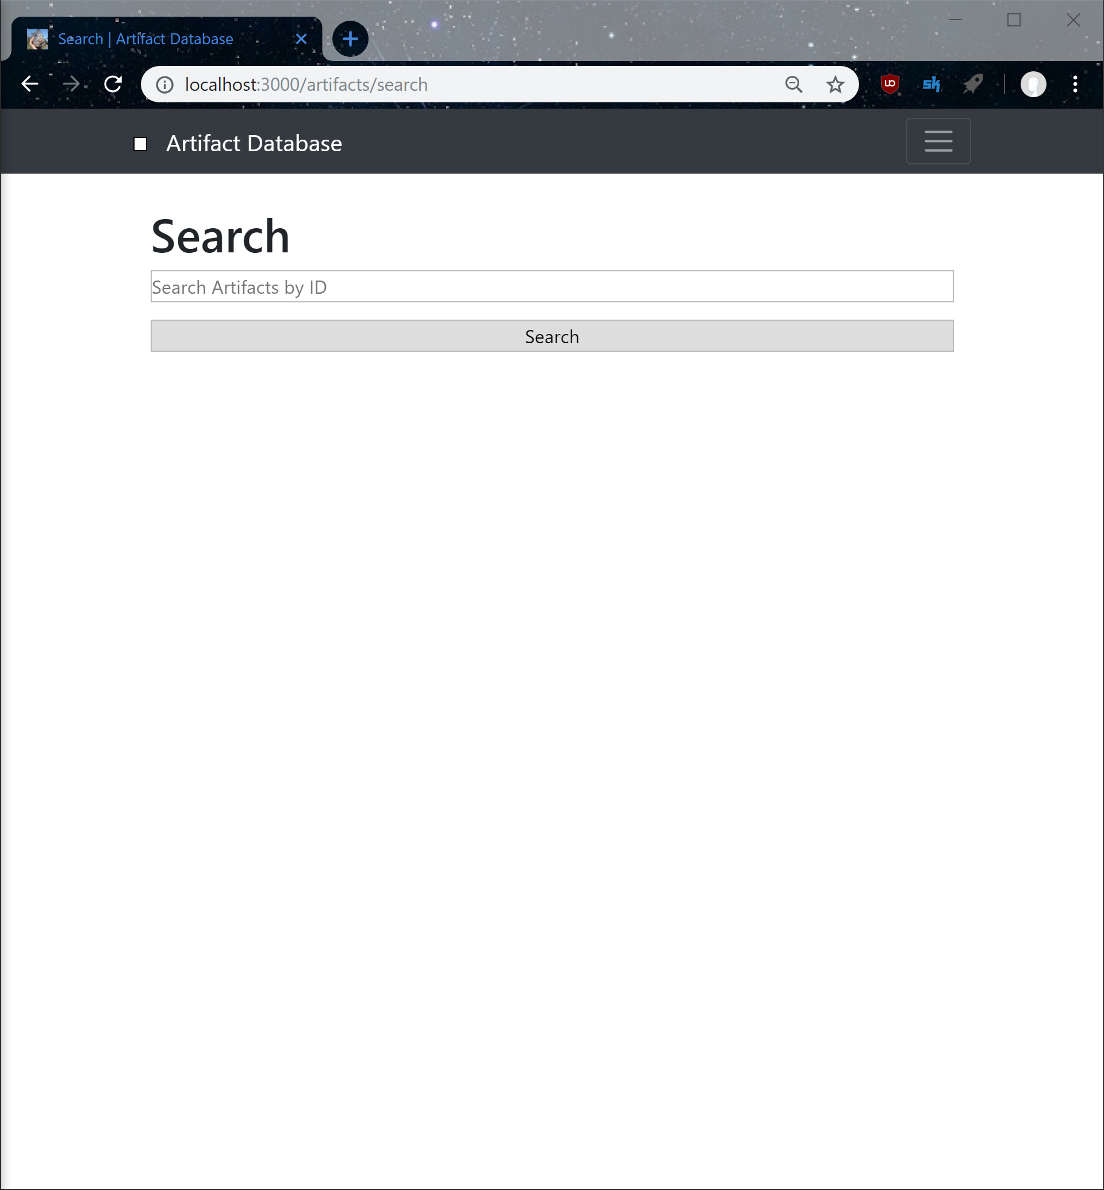
To Do
Implement Search
Create Checkout page
Get QR Reader to redirect to artifact
Administration Page
Format and optimize site for Mobile platforms
Make the site look good (CSS time)

Slide 6
End

